Slide 1

Stock Code:1802
TAIWAN GLASS IND. CORP.
Spokesperson: Lin, C M
GM, Finance Dept.
Provide satisfactory products to our customers through advanced technology and Total Quality Management (TQM).
2021-11-18

Slide 2
Disclaimer
This brief and the related information issued meanwhile were obtained from internal and external data of the Company and the operation perspectives, it reflected the viewpoints to the future. If there is any change or adjustment in the hereafter, the Company has no responsibility to remind or update.
➢
The Company did not issue financial forecasts. The financial, business or Q&A explanations may differ from actual result in the future. The reasons of differences may include the changed market demand, unsettled factory and material price, industrial competition, international economic situation, exchange rate fluctuation, suppliers and retailers supply chain, and etc. which can not be controlled by the Company.

Slide 3
Outlines
Introduction of Taiwan Glass Group
Production Facilities
Product Introduction
General Operation Situation of 2021
Situation and Development of the Market
Q&A

Slide 4
Introduction of Taiwan Glass Group
Founded in | 1964
Capital | NTD$29.08 billion
Chairman | Mr. Lin, Por Fong
Number of Employee | 12,880 (until 2021.9.30)
Date of Listing | Listed in 1973
Main Products | Flat Glass Fiberglass Glassware

Slide 5
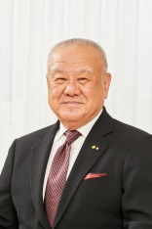
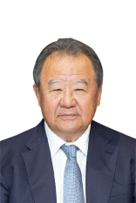
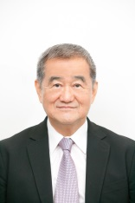
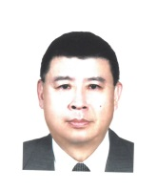
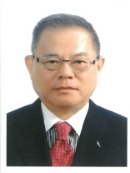


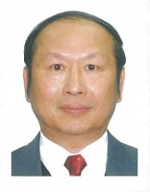
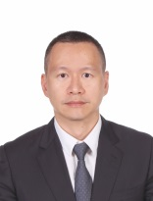
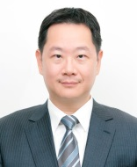
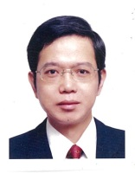

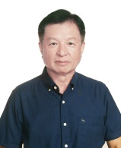
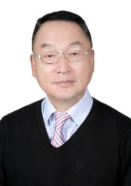

Introduction of Taiwan Glass Group
TGI 20th Directors / 3rd Audit Committee (2021-2024)
Lin, P F
Lin, P S
Lin, P C
Lim, H T
Peng, C H
Hsu, L L
Lin, C H
Lin, C Y
Lin, C M
Tsai, T M
Su, Y T
Lien, S W
Lin, S C
Lin, Z Y
Wang, Y C

Slide 6
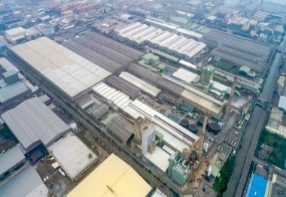
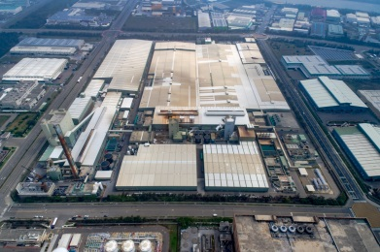
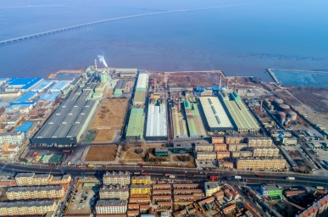
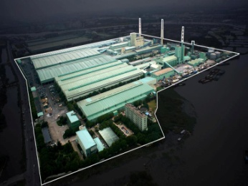
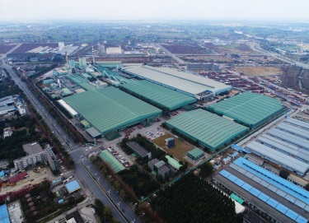
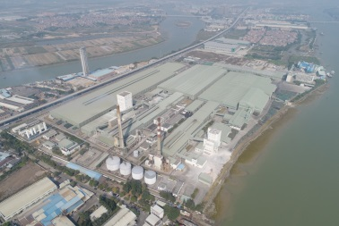
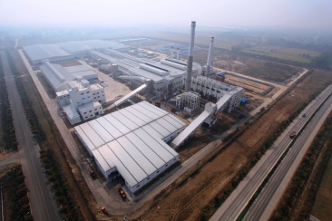
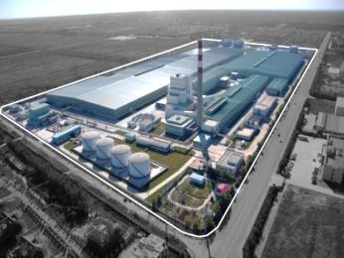
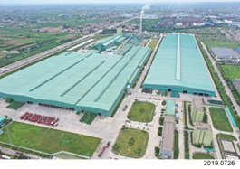
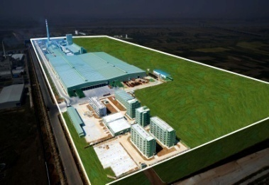
Production Facilities - Flat Glass
Taiwan Taichung Factory (TF) | Taiwan Lukang Flat Glass Factory (TF-4) | TG Qingdao Glass Co., Ltd. (QFG) Qingdao Rolled Glass Co., Ltd. (QRG) | TG Changjiang Glass Co., Ltd. (CFG) | TG Chengdu Glass Co., Ltd. (CDG)
250,068 M² | 260,343 M² | 429,126 M² | 404,770 M² | 452,027 M²
1 Furnace 140,000 mt/y | 1 Furnace 200,000 mt/y | 1 Furnace 150,000 mt/y | 2 Furnaces 383,250 mt/y | 2 Furnaces 470,000 mt/y
TG Huanan Glass Co., Ltd. ( HNG) | TG Donghai Glass Co., Ltd. (DHG) | TG Tianjin Glass Co., Ltd. (TJG) | TG Xianyang Glass Co., Ltd. (TXY) | TG Anhui Glass Co., Ltd. (TAH)
364,907 M² | 398,096 M² | 300,448 M² | 452,703 M² | 572,643 M²
2 Furnace 372,000 mt/y | 2 Furnaces 400,000 mt/y | 1 Furnace 180,000 mt/y | 1 Furnace 438,000 mt/y | 1 Furnace 438,000 mt/y
天津廠
6

Slide 7
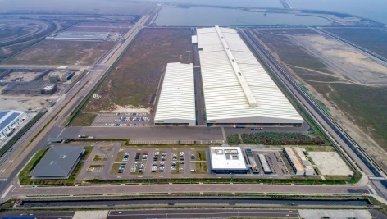
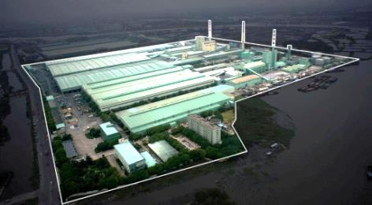



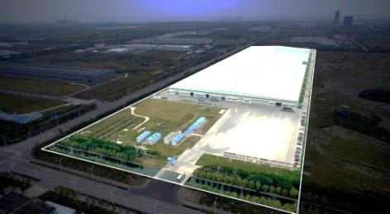
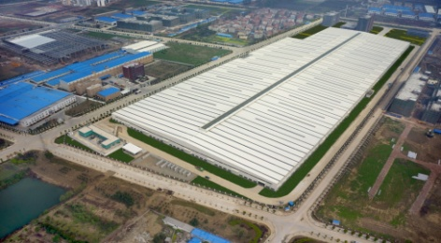
Production Facilities - Low-E Glass
Taiwan Changpin Factory (TC) | TG Changjiang Glass Co., Ltd. (CFG) | TG Chengdu Glass Co., Ltd (CDG) | TG Huanan Glass Co., Ltd. ( HNG)
272,480 M² | 404,770 M² | 452,027 M² | 364,907 M²
1 Line 4,000,000 m²/y | 1 Line 4,000,000 m²/y | 2 Lines 10,000,000 m²/y | 1 Line 6,000,000 m²/y
TG Tianjin Glass Co., Ltd. (TJG) | TG Xianyang Glass Co., Ltd. (TXY) | TG Taichang Architectural Glass Co., LTd. (TTAR) | TG Wuhan Architectural Glass Co., Ltd. (TWAR)
300,448 M² | 452,703 M² | 199,525 M² | 222,000 M²
1 Line 4,000,000 m²/y | 1 Line 7,800,000 m²/y | 1 Line 4,500,000 m²/y | 1 Line 5,800,000 m²/y
7

Slide 8
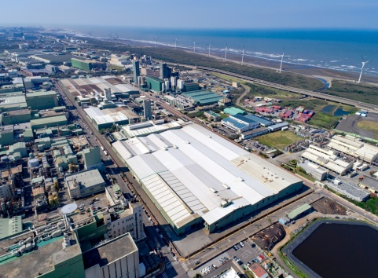
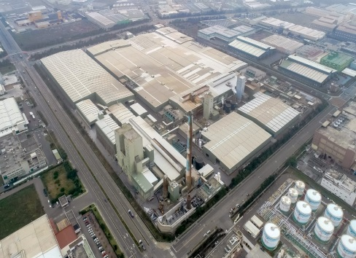
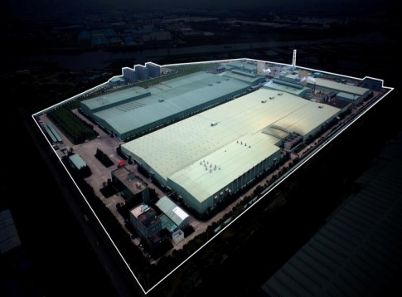
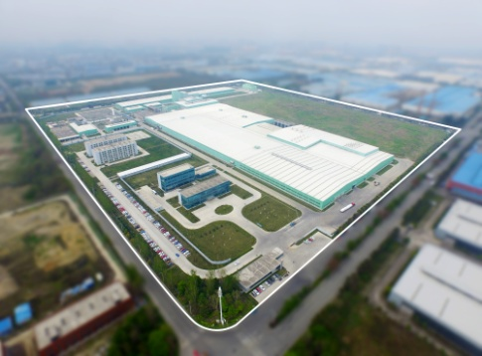
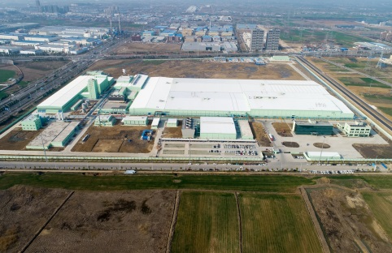
Production Facilities –
Fiberglass Reinforced / Fiberglass Fabric
Taiwan Taoyuan Factory (TT) | Taiwan Lukang Factory (TL) | Taichia Glass Fiber Co., Ltd. (TGF) | Taichia Chengdu Glass Fiber Co., Ltd. (TCD)
181,181 M² | 260,343 M² | 323,539 M² | 362,668 M²
1 FRP Fiberglass Fabric 80,000mt/y | 1 Electronic Grade FRP Fiberglass Fabric 20,000 mt/y | 3 Electronic Grade FRP Fiberglass Fabric 30,000 mt/y | 1 Electronic Grade FRP Fiberglass Fabric 30,000 mt/y
370,668M²
1 Electronic Grade FRP Fiberglass Fabric 35,000 mt/y
8

Slide 9
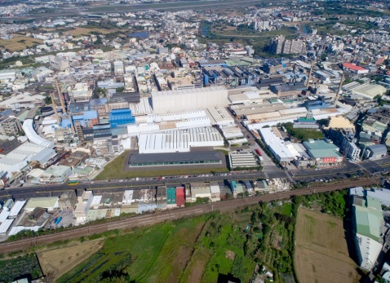
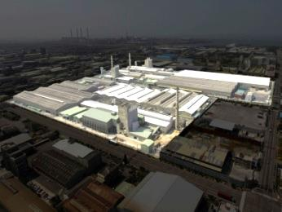
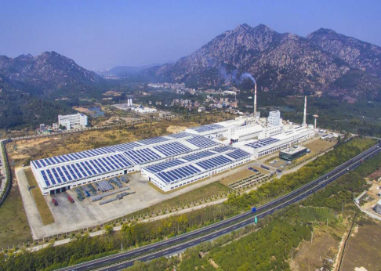

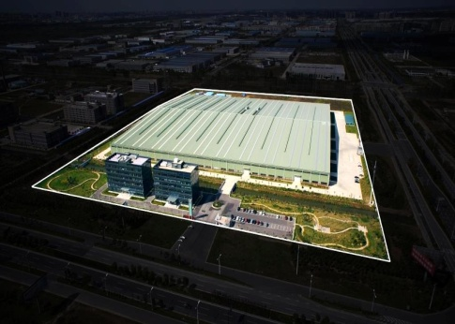
Production Facilities – Container & Tableware / Ultra-Thin Glass / Photovoltaic Glass / Automotive Glass
Container & Tableware | Ultra-Thin Glass | Photovoltaic Glass
Taiwan Hsinchu Factory (TS) | Taiwan Taichung Factory (TF-5) | TG Fujian Photovoltaic Glass Co., Ltd. (FPG)
129,090 M² | 250,068 M² | 388,822 M²
6 Container 、1 Kitchenware 169,000 mt/y | 1 Ultra-Thin Glass 29,280 mt/y | 1 Photovoltaic Glass 237,250 mt/y
Automotive Glass
Taiwan Autoglass Ind. Corp. (TAGC) | TG Yueda Autoglass Co., Ltd. (TYAU)
250,068 M² | 132,755 M²
1 Automotive Glass 250,000 units | 5 Automotive Glass 2,000,000 units
9

Slide 10
Main Business and Products
Division | Product Category
Flat Glass Division | ● Clear Float Glass ● Tempered Glass ● Tinted Float Glass ● Ceramic Silkscreen/Spandrel Glass ● Rolled Glass ● Heat Strengthened Glass ● Low-E Glass ● Laminated Glass/Sound Control Laminated Glass ● Low-E Vacuum Glass ● Bent Glass/Bent Tempered Glass ● Reflective Glass ● Mirror Glass
Fiber Glass Business | ● Fiberglass Yarn ● Glass Yarn ● Fiberglass Fabric
Container, Tableware & Kitchenware | ● Glass Container ● Tableware ● Kitchenware ● Tableware/Kitchenware Glass Processing ● Private Label Products
New Material Business | ● Ultra-Thin Glass
Solar Business | ● Super Clear Glass ● Low Iron Photovoltaic Cover Glass
Automotive Glass Business | ● Auto Glass

Slide 11
Green Products
Notes:
In recent years, TG has obtained a number of quality and environmental protection certifications. TG, in response to global green energy issues, has also devoted itself to reducing pollution in the production process to mitigate impacts on the environment, aiming at the development of environmental protection and energy-saving products.

Slide 12
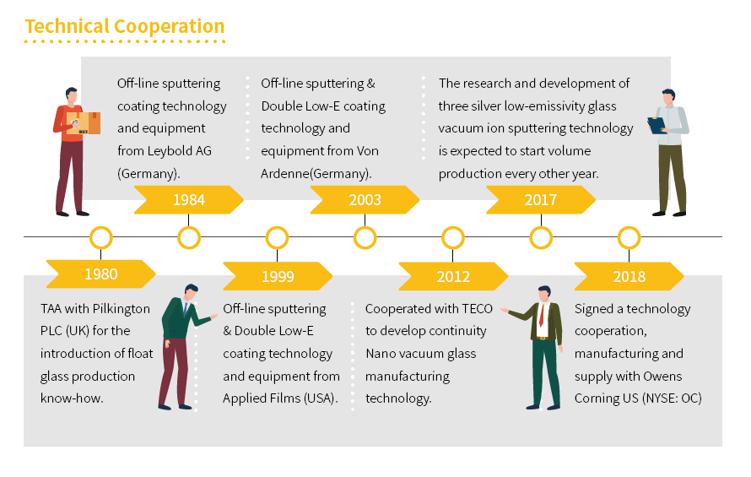
Product Introduction
Flat Glass
TGI’s flat glass has 100% passed the EU CE, US ANSI, Taiwan CNS and other relevant standards. In the production of the flat silver mirror TGI uses advanced lead-free copper process, to avoid heavy metal pollution. TGI also actively promotes the hot-dip process to strengthen glass, even if broken it will become small pieces to reduce harm. Laminated Glass has the PVB interlayer withstands penetration from impact. Even if the glass cracks, splinters will adhere to the interlayer and not scatter. In comparison with other kinds of glass, laminated glass has much higher strength to resist shock, burglary, burst and bullets. Cladding, coating, vacuum and other energy-saving glass has more excellent thermal insulation so it can reduce the heat exchange of indoor and outdoor to save air conditioning usage, and indirectly reduce greenhouse gas emissions.
Technical Cooperation

Slide 13
Product Introduction
Green Product - Flat Glass
The new generation of energy-saving glass products, Low-E glass, can effectively block thermal radiation from the sun while maintaining good light transmittance, which provides good lighting and heat insulation and saves a great deal of energy consumption in air conditioning. Taiwan Glass Low-E glass products have met the CNS12681 standard and obtained ISO 9001 international quality assurance certification and the IGCC quality certification. Low-E glass has been widely used in buildings.
Taiwan Glass adopts the most advanced coating technology to develop silver-free Low-E (JN88). Compared with the general Low-E coating, the JN88 film structure no longer contains the typical material of the general Low-E coating—silver. JN88 uses hard semi-conductor nanofilm, which still maintains a very low surface emissivity, having excellent heat preservation. The film’s high hardness, abrasion resistance, and oxidation resistance allow JN88 to be free from oxidation and film deterioration when exposed to air. The invention of JN88 has added to the variation of applications of offline Low-E glass.
The use of JN88 indoors can not only ensure the stability of the product but also significantly reduce the thermal conductivity of laminated glass and monolithic glass, reducing energy consumption effectively to enhance the energy-saving and value of buildings. After adopting double Low-E cladding, the U value of single-cavity cladding glass is close to that of double-cavity cladding glass, which directly reduces the cost of the curtain wall and the load of curtain wall on the building. This greatly reduces energy consumption and the investment cost of buildings.

Slide 14
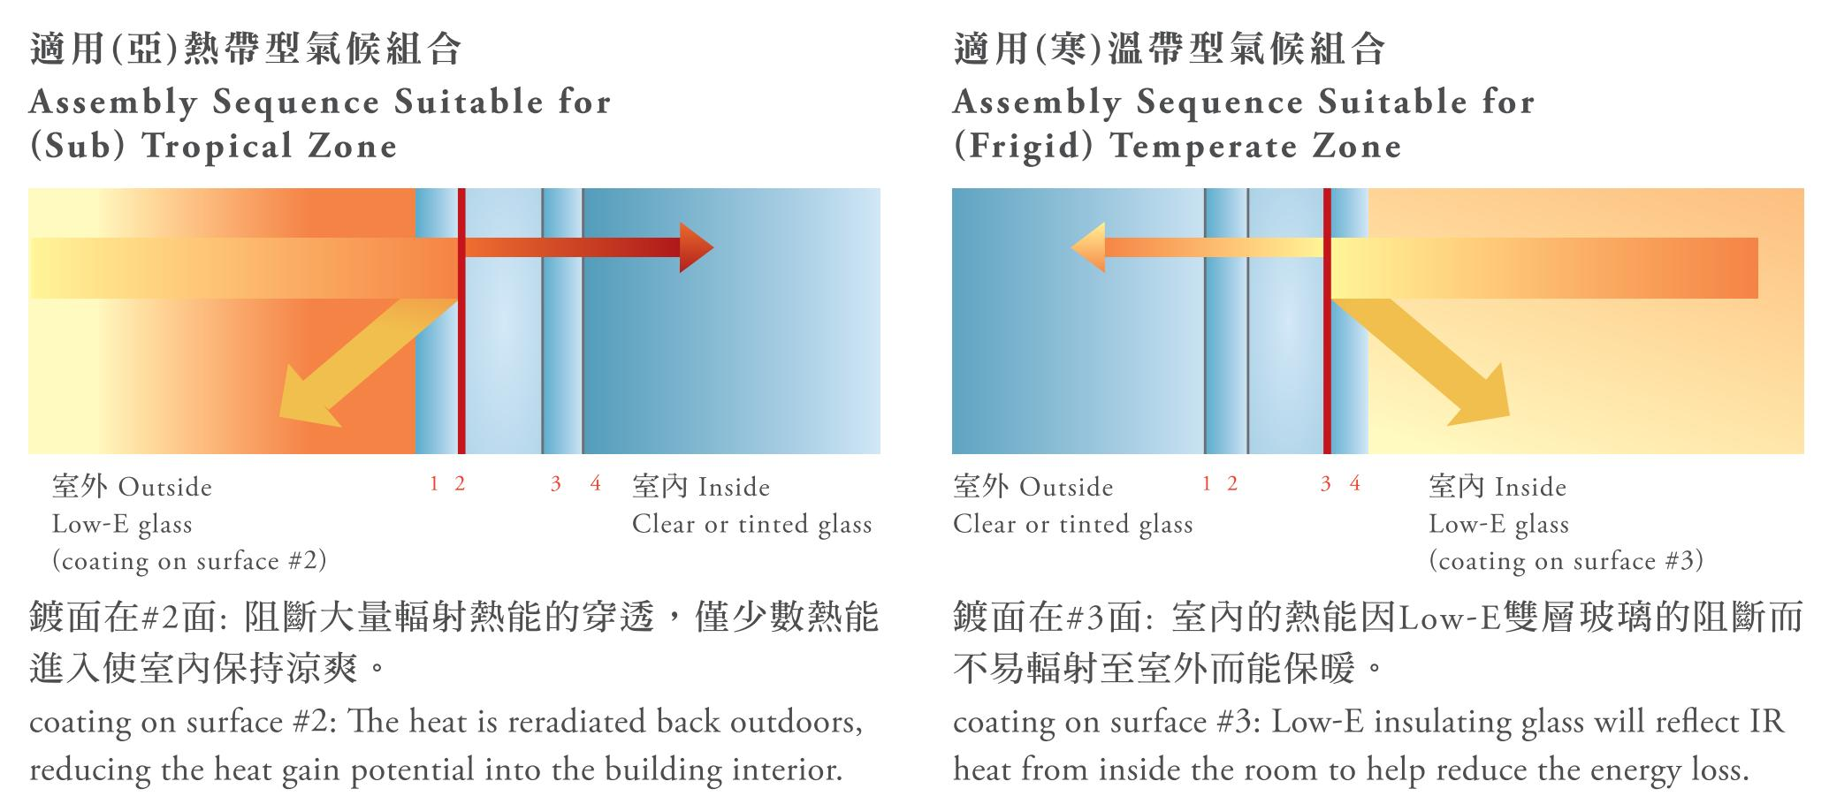
Product Introduction
Low-E (Low-Emissivity) glass is the best building material to reduce heat from sunlight as it can deflect most ultraviolet and infrared radiation, preventing the indoor temperature from rising, conserving energy, and reducing carbon emission. Thermal radiation from the sun mainly contains ultraviolet, visible light, and infrared radiation. Emissivity (ε value, the lower the value, the higher the effectiveness for heat insulation is) glass' ability to emit heat radiation from the sun. Low-E glass utilizes its coating to block the heat radiation from the sun. According to China's GB standards, only coated glass with emissivity (ε value) lower than 0.25 can be labeled as Low-E glass.

Slide 15
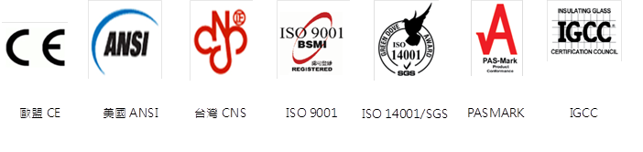
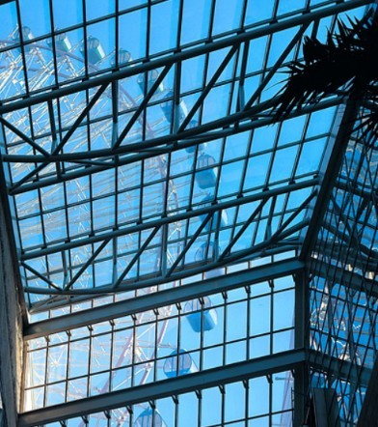


Product Introduction
Certifications of Flat Glass
Please scan the QR code for more information about flat glass.

Slide 16
Product Introduction
Fiberglass
Compared with metal support materials, fiberglass has excellent corrosion resistance and weather resistance, and at the same time has the advantages of low cost, high strength/weight ratio, and longer service life. According to the different weaving structure and characteristics of fiberglass fabric, it has a wide variation and vastly used for heat preservation, heat insulation, fire prevention, and material reinforcement. TGI's fiberglass products all meet RoHS and REACH requirements. For food contact products, 4 products meet US FDA standards; 8 products meet EU 10/2011 regulation and have Germany's BfR approval; 2 products meet France's requirements for drinking water (CAS). The quality of our products meets CNS (National Standards of the Republic of China). We print the CNS logos on labels according to different customer needs. The packaging labels of fiberglass fabric and fiberglass yarn are marked with RoHS compliant logos.
With the advent of the 5G era in 2020, global information transmission has entered an era of high frequency and high speed. Printed circuit boards (PCB) for Netcom equipment must use Low DK materials to meet the 5G high-frequency and high-speed performance requirements. Following the United States and Japan, TGI became the third manufacturer to successfully develop Low DK fiberglass fabric for high-end PCBs and has been certified by domestic and foreign terminal manufacturers to be used in 5G equipment. The 5G boom has been postponed due to the outbreak of COVID-19 in 2020. However, as the 5G infrastructure continues around the world, more and more car manufacturers are adding electric vehicles to their lineups. It is expected that the demand for fiberglass fabric will grow rapidly in 2021. TG will continue to meet customers’ needs by increasing the production of Low DK and ultra-thin fabric, and continue to develop thinner and higher value-added products.

Slide 17


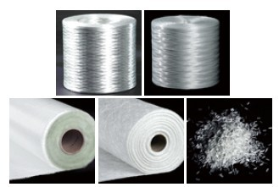
Product Introduction
Please scan the QR codes for more information about fiberglass.
Direct Roving (DR),
Conventional Roving (CR),
Woven Roving (WR),
Chopped Strand Mat (CSM), Chopped Strand (CS/O-CS)

Slide 18
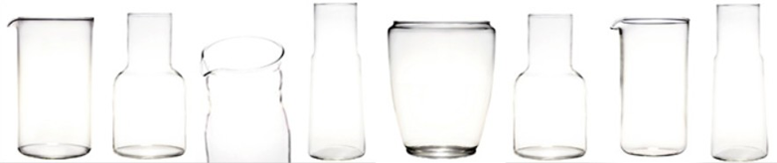
Product Introduction
Glass container, tableware, and kitchenware
Glass container, tableware, and kitchenware
Glass containers, with excellent transparency, showcase the real color of anything inside containers. Advantages such as easy sealing, long-time storage and suitableness for microwave heating make these containers a necessity for modern people. The manufacturing facility of the container, tableware, and kitchenware has received ISO9001 and FSSC 22000 certification. All products meet Taiwan's Sanitation Standard for Food Utensils, Containers and Packages. TGI can also provide products that meet RoHS and REACH standards based on clients' needs. For our heat-resistant products, all of our baby feeding bottles meet EU's latest EN 14350 standard. Coffee pots come with heat-resistant labeling upon clients' requests.
In 2019, we made every effort to develop the high-price special-shaped bottles. Heat-resistant containers will continue to consolidate the glass bottle market and expand new customer base. TGI also established a recycled glass processing center to clean and reuse recycled glass, and regularly send samples of SGS to test the lead content. In addition, we scrapped the waste glass in the factory and also recycled it through metal detector inspection. Regarding the output and recycling part of customers' waste glass after sales, they will cooperate with Spring Pool Glass to recycle and sell the waste glass to the middle and downstream glass factories, clean and inspect with a metal detector to remove most of the metal contaminants like stainless steel, aluminum, copper, tin, etc. to improve quality of production. In 2020, the average recycling rate reached 54.92% and we will commit ourselves to better recycling rates.
Notes:
Glass container, tableware, and kitchenware
Glass containers, with excellent transparency, showcase the real color of anything inside containers. Advantages such as easy sealing, long-time storage and suitableness for microwave heating make these containers a necessity for modern people. The manufacturing facility of the container, tableware, and kitchenware has received ISO9001 and FSSC 22000 certification. All products meet Taiwan's Sanitation Standard for Food Utensils, Containers and Packages. TGI can also provide products that meet RoHS and REACH standards based on clients' needs. For our heat-resistant products, all of our baby feeding bottles meet EU's latest EN 14350 standard. Coffee pots come with heat-resistant labeling upon clients' requests.
In 2019, we made every effort to develop the high-price special-shaped bottles. Heat-resistant containers will continue to consolidate the glass bottle market and expand new customer base. TGI also established a recycled glass processing center to clean and reuse recycled glass, and regularly send samples of SGS to test the lead content. In addition, we scrapped the waste glass in the factory and also recycled it through metal detector inspection. Regarding the output and recycling part of customers' waste glass after sales, they will cooperate with Spring Pool Glass to recycle and sell the waste glass to the middle and downstream glass factories, clean and inspect with a metal detector to remove most of the metal contaminants like stainless steel, aluminum, copper, tin, etc. to improve quality of production. In 2020, the average recycling rate reached 54.92% and we will commit ourselves to better recycling rates.

Slide 19
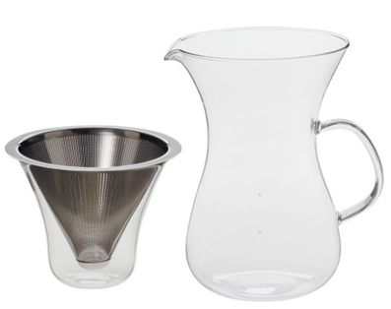
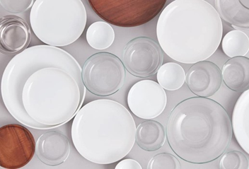

Product Introduction
Private Brand - TG
TGI's technique to produce glass containers and tableware has been able to compete with international recognized brands. Therefore, we established our private brand, TG. TG targeted the new audiences who pay attention to lifestyle. Besides, in order to create the brand image and build the products style, we invited Fukasawa Naoto, who is a Japanese master of industrial design, to plan and design with his observation of Taiwanese culture. He merged the feelings such as “kindness”, “mild” and “nature” into the design, bringing glass containers a whole new life.
Please scan the QR code for more information.
Notes:
TGI's technique to produce glass containers and tableware has been able to compete with international recognized brands. Therefore, we established our private brand, TG. TG targeted the new audiences who pay attention to lifestyle. Besides, in order to create the brand image and build the products style, we invited Fukasawa Naoto, who is a Japanese artist of industrial design, to plan and design with his observation of Taiwanese culture. He merged the feelings such as “kindness”, “mild” and “nature” into the design, bringing glass containers a whole new life.

Slide 20
Product Introduction
TG has been awarded in the 29th Taiwan Excellence Award for “Heat-Resistant Water Pitcher” and certified as Taiwan Good Craft for “Glass Storage Jar with Taiwan Acacia Lid” in 2020. We hope the new brand could extend into global markets with its base in Taiwan.
Notes:
TG has been awarded in the 29th Taiwan Excellence Award for “Heat-Resistant Water Pitcher” and certified as Taiwan Good Craft for “Glass Storage Jar with Taiwan Acacia Lid” in 2020. We hope the new brand could extend into global markets with its base in Taiwan.

Slide 21
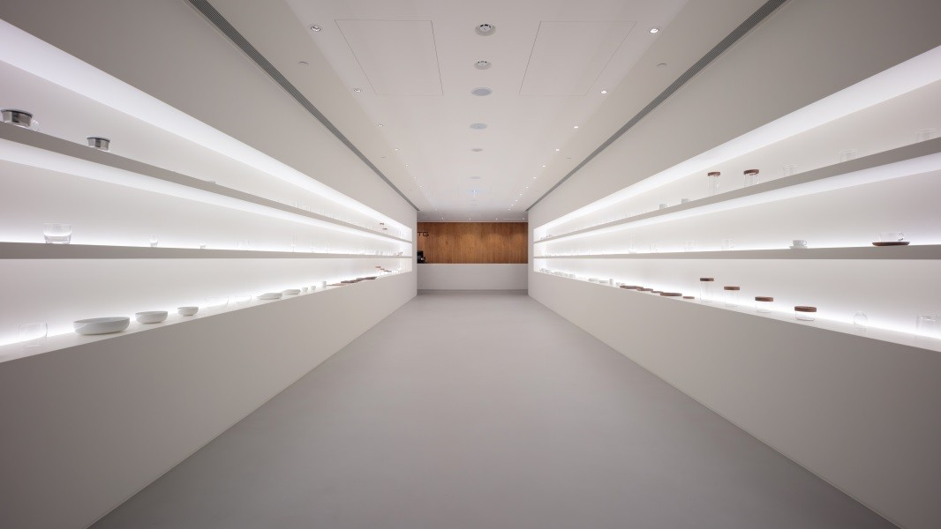
Product Introduction
TG flagship store opened on December 15, 2020 on the first floor of the Taiwan Glass Building on Nanjing East Road. The interior was designed by Naoto Fukasawa and Taiwan's architect Hou, Jen-Suh (Ho + Hou studio Architects). It is also the first business space designed by Naoto Fukusawa, including a new series of glass products, logo, package, and interior design. The windows display in the flagship store are the TG products photographed by Tamotsu Fujii, a famous Japanese commercial photographer.
Notes:
TG flagship store opened on December 15, 2020 on the first floor of the Taiwan Glass Building on Nanjing East Road. The interior was designed by Naoto Fukasawa and Taiwan's architect Hou, Jen-Suh (Ho + Hou studio Architects). It is also the first business space designed by Naoto Fukusawa, including a new series of glass products, logo, package, and interior design. The windows display in the flagship store are the TG products photographed by Tamotsu Fujii, a famous Japanese commercial photographer.

Slide 22
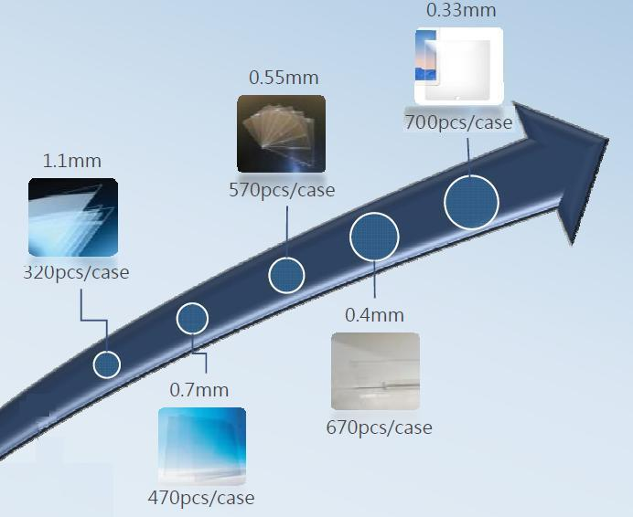
Product Introduction
Ultra-Thin Glass
The TF5 furnace in Taichung Factory is a newly established production line for Ultra-thin touch glass. Introducing the installations of Computerized Automated Production Management System, cleanroom and mechanical arms for collecting glass panes, this line started production in November 2014 with mass production for 0.33~1.1mm glass. The 0.55~0.11 glass could be used for ITO touch panels and the 0.33~0.4mm glass could be used as screen protector for 3C products. All of the products undergo strict inspections before shipment. The high-quality product is able to provide for major electronic manufacturers at home and abroad to produce consumer electronic goods.

Slide 23
General Operation Situation of 2021

Slide 24
General Operation Situation of 2021

Slide 25
General Operation Situation of 2021

Slide 26
Situation and Development of the Market
Flat Glass
Flat glass accounts for more than 60% of the operating income of the Taiwan Glass Group, with China being our main market. Compared with the slow economic recovery resulted from the pandemic in the United States and European countries in 2020, China has gradually got rid of the impact of the COVID-19 pandemic, which contributes to China’s positive GDP growth in 2020 and its fastest recovery from the pandemic in the world.
In 2021, in order to maintain the momentum of economic growth, China turns to domestic demand expansion and emphasizes internal circulation to boost the economy. Increased demand in the terminal glass market leads to overall price increase in flat glass. Taiwan Glass Group's consolidated operating income for flat glass in the first three quarters of 2021 increased by 51% compared with the same period; operating profit increased by NT$6.15 billion.
However, in the fourth quarter of 2021, due to the dual control policy of energy and consumption in China and the upcoming winter construction site shutdown period in northern China areas, sales volume and sales prices are expected to drop.
Looking forward to 2022, the China flat glass market will continue to withdraw furnace production lines that are not compliant with environmental regulations. Coupled with increased amount of architectural glass in response to energy-saving requirements, it is expected that the overall glass industry demand will still exceed the supply.

Slide 27
Situation and Development of the Market
Fiberglass
As for electronic-grade fiberglass fabric, the first three quarters of 2021 benefited from the boom in the downstream market, with increased demand and short in supply. The price of fiberglass fabric increased compared with the same period, and the boom is expected to continue.
In addition, TGI’s low-dielectric fiberglass fabric matches with well-known copper clad laminate (CCL) factories at home and abroad in 2020, and has been recognized among major international terminal manufacturers for use in 5G equipment, high-end servers, automotive devices, high-end graphics cards, etc. The high-frequency and high-speed performance of 5G will increase the demand for upgraded optical communications. Although the global 5G infrastructure has been delayed due to the impact of the COVID-19 pandemic, 5G has become a global development trend. Notwithstanding the delayed development, the 5G infrastructure remains the same.
For FRP, with the gradual economic recovery of automobiles, electronic appliances and the global economy, the production and sales in 2021 has returned to the normal. It is expected that the FRP market supply and demand in 2022 will not change much if the pandemic is properly controlled around the world.
Notes:
In addition, TGI’s low-dielectric fiberglass fabric matches with well-known copper clad laminate (CCL) factories at home and abroad in 2020, and has been recognized among major international terminal manufacturers for use in 5G equipment, high-end servers, automotive devices, high-end graphics cards, etc.

Slide 28
Situation and Development of the Market
Glass Containers
The demand of domestic and foreign customers has grown steadily. The export market is mainly focused on the United States. Fewer export shipments than estimated can be contributed to the lack of flight, lack of shipping containers and port congestion since 2021. The shipments are expected to be back to normal in the first quarter of 2022 after the aforementioned issues are addressed. In addition, to bridge the gap between actual and expected amount of export shipments, the company tenders for domestic contracts such as liquor bottles and alcohol spray bottles. In summary, the overall sales revenue of 2021 is slightly lower than that of 2020 due to the lack of shipping containers for glassware.
In the fourth quarter of 2021, the production lines of heat-resistant containers and kitchenware have been merged into one kiln and two production lines, with production by turns. The main production is high value-added products and products with lower prices are eliminated to reduce costs. The Company will continue to balance production & sales and destock. It is expected that heat-resistant containers and kitchenware products will turn a profit in 2022.

Slide 29
Q&A
感謝聆聽 謝謝指教
Thanks for your attention.
Have a great day.

